Slide 1
Advanced Web Programming
Day 3 Lots of code

Slide 2
Hyperlinks
Creating a linked document

Slide 3
Anchor links
The <a> tag stands for anchor link
Needs a hyper-reference AND content
href: reference to location of new content
content: the “clickable” part (text or image)

Slide 4
Types of links
Absolute
Relative
Internal
Graphical

Slide 5
Absolute reference
<a href="http://www.intro-webdesign.com/">Web Design</a>
Closing
tag
Where to go on click
Opening tag
Clickable text

Slide 6
Relative References
Link to a local file in the same folder
Link to a local file in a different folder called “docs”
Link to a different location in the same file

Slide 7
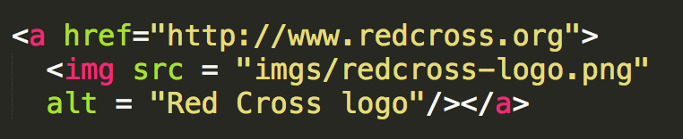
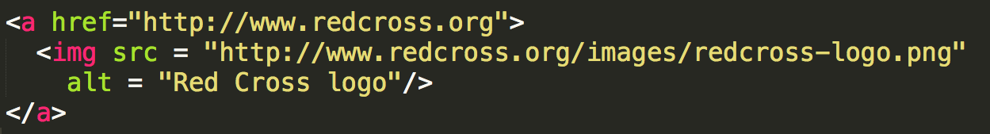
Using Images as the Link
The “clickable” component doesn’t have to be text.

Slide 8
Targets
Anchors can take a target attribute
_blank – open in new tab or window
explore W3schools

Slide 9
Multimedia
Adding video and audio materials

Slide 10
Video element <video>
Video tag uses a src attribute or embedded <source>
Common attributes
height, width
autoplay
loop
controls
Text inside <video>..</video> is displayed if browser can not support tag

Slide 11
video syntax
<video src="sample1.MOV" autoplay muted width="320" height="240">
</video>

Slide 12
Audio element <audio>
Audio tag uses a src attribute to link to audio file, typically .mp3 or .wav
Common attributes
autoplay, controls, loop
buffered
muted
volume

Slide 13
Setting clips
You can set both the video and audio elements to play clips by adding to the src attribute.
.ext#t=5, 25
.ext#t=, 39
.ext#t=, 1:38:45
.ext#t=42

Slide 14
Tables
Displaying your Data

Slide 15
Design
Make sure to sketch your layout before you code.
Decide on the number of rows and columns
Decide if any rows/columns will span multiple cells

Slide 16
The Tags
<table> – the container tag
<tr>…</tr> - the rows
<td>...</td> - the columns

Slide 17
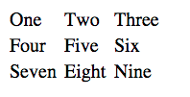
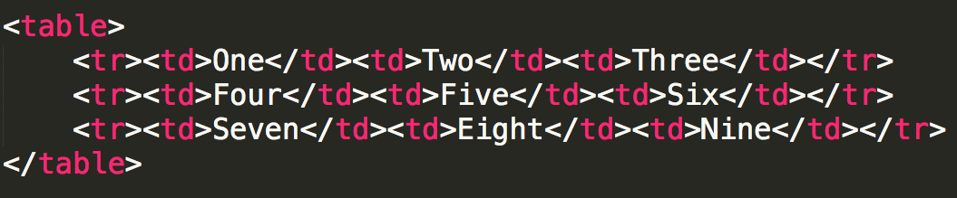
Simple Table

Slide 18
Table Headings
How would you add table headings? (The bold cells at the top that define the data.)
Some people use bold font, we use semantic tags
<th>..</th> -- table heading

Slide 19
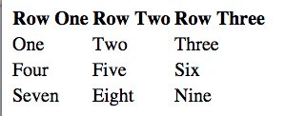
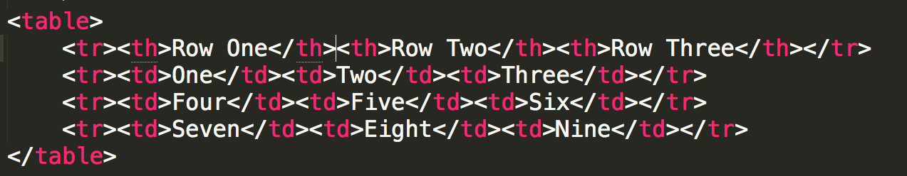
Table Headings

Slide 20
Spanning Multiple Cells
It may be the case that your table won’t be a perfect grid.
You can combine multiple rows and/or columns using the rowspan and colspan attributes.

Slide 21
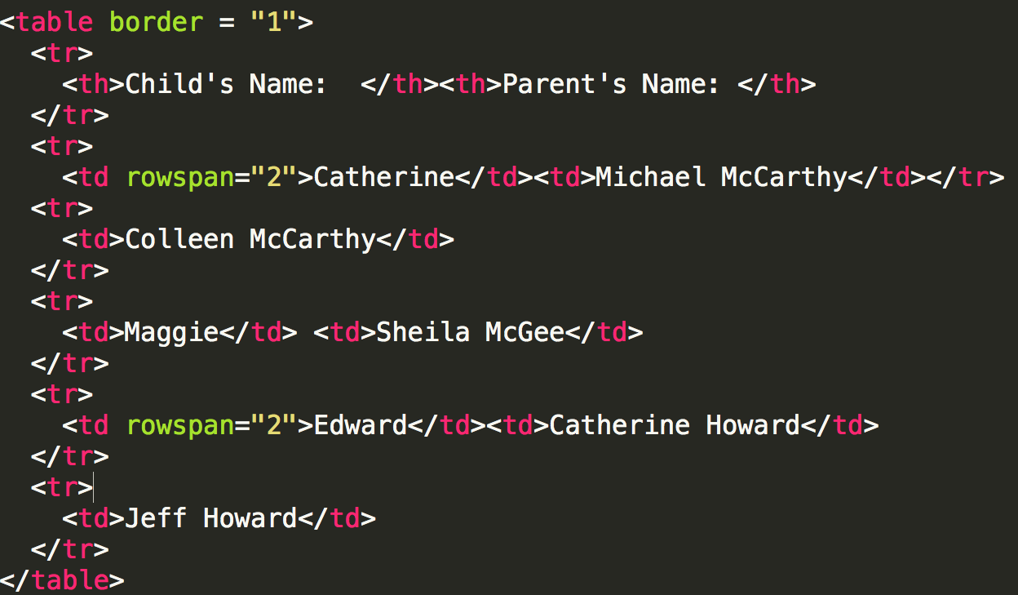

Slide 22
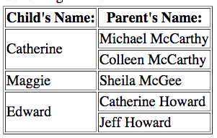

Slide 23
The Border Attribute
There are a number of attributes that tables can take, but in your HTML you should avoid styling.

Slide 24
Captions
How do you link text to the table? A heading (h2, h3, etc.) will look good, but doesn’t provide semantics.
Use <caption>

Slide 25
Review
Tables should only be used for tabular data
Draw your table before you code your table
Check for unclosed tags

Slide 26
Useful Tags
Tags for blocks of code and
simple snippets

Slide 27
Choosing Your tags
Generic: <p>, <div>
Semantic: <header>, <nav>, <footer>, <figure>
Team from w3schools

Slide 28
Block Tags
Containers
<article>, <aside>, <section>, <main>, …
<hr>
<address>
<blockquote> - has cite attribute
<details> with <summary>

Slide 29
Inline tags
<span> was the original inline tag for plain text
<cite>
<abbr
<time>
<code>
<sub> and <sup>

Slide 30
Tags that need “more”
<button>
<meter>
<progress>
<iframe> – often used to embed documents
<bdo> attribute dir (ltr or rtl)
<map> with <area> -- creates “clickable element in image” but needs JavaScript
Notes:
While <progress> is used to convey how much work in a task has been completed, the <meter> element is used to display a measurement on a known scale.

Slide 31
Review
Use the most specific tag possible
Sometimes tags “don’t work”
Run your code through a validator, you may have a syntax error
Run your code in multiple browsers (good idea even if your code looks good)

Slide 32
Happy coding!!!
Use w3schools extensively

